Slide 1

Welcome to the Baldwin Museum
Explore the World of Science

Slide 2
Permanent Exhibits
Space and Astronomy
The Mechanical World
Oceans and Seas
Why Math Is Necessary
Science and the Arts

Slide 3
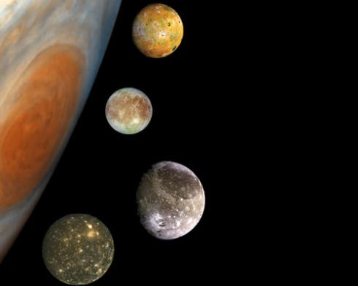
Space and Astronomy
Our Solar System
Stars and Planets
Comets, Asteroids and Other Flying Objects
The Big Bang
How Gravity Works
Space Travel and Exploration
Careers in Space

Slide 4

The Mechanical World
The Gears of Industry
Bridging Rivers, Bridging Time
Powering Our World
How Things Move
Engineering Feats
Mechanical Marvels
Transportation

Slide 5
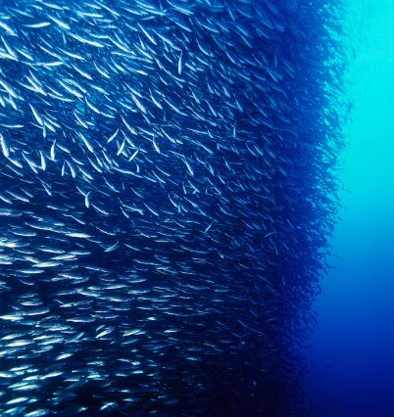
Oceans and Seas
The Ocean Zones
Marine Biology
Undersea Exploration
The Changing Food Chain
The Oceans’ Effect on Weather
Careers in the Ocean Sciences

Slide 6
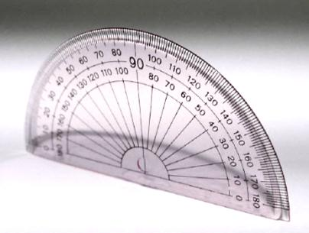
Why Math Is Necessary
Great Moments in Math
Math in Other Sciences
Where Did Numbers Come From?
Math and Daily Living
Math and Exploration
Careers in Math and Physics

Slide 7

Science and the Arts
The Science of Sound
Special Effects Wizardry
3D Animation
Uncovering Secrets of the Masters
Computerized Compositions

Slide 8
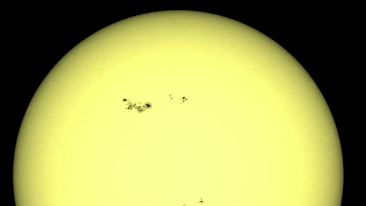
New! All About Sun Spots
What are sun spots?
How do they affect life on Earth?
Find out in the Astronomy Pavilion during today’s visit!

